Slide 1
Employee Management System
By –
Dhruv Bhati – 18etccs029
Jatin Menaria – 18etccs047
Mohit Menaria – 18etccs063
Suryaveer Singh – 18etccs087

Slide 2
List of Contents
Introduction
Abstract
Objective
Software Life Cycle
Diagram
Conclusion
Future Scope

Slide 3
Introduction
The “EMPLOYEE MANAGEMENT SYSTEM” has been developed to override the problems prevailing in the practicing manual system. This software is supported to eliminate and in some cases reduce the hardships faced by this existing system. Moreover this system is designed for the particular need of the company to carry out operations in a smooth and effective manner. The application is reduced as much as possible to avoid errors while entering the data. It also provides error message while entering invalid data. No formal knowledge is needed for the user to use this system. Thus by this all it proves it is user-friendly. Every organization, whether big or small, has human resource challenges to overcome. every organization has different employee management needs, therefore we design exclusive employee management systems that are adapted to your managerial requirements. This is designed to assist in strategic planning, and will help you ensure that your organization is equipped with the right level of human resources for your future goals. Also, for those busy executive who are always on the go, our systems come with remote access features, which will allow you to manage your workforce anytime, at all times. These systems will ultimately allow you to better manage resources. One of the main features in employee management system is time tracking for employees. Effective time tracking mechanism saves both time and money for the organization.

Slide 4
Abstract
The purpose of Employee Management System is to automate the existing manual system by the help of computerized equipments and full-fledged computer software, fulfilling their requirements, so that their valuable data/information can be stored for a longer period with easy accessing and manipulation of the same. The required software and hardware are easily available and easy to work with. Employee Management System, as described above, can lead to error free, secure, reliable and fast management system. It can assist the user to concentrate on their other activities rather to concentrate on the record keeping. Thus it will help organization in better utilization of resources. The organization can maintain computerized records without redundant entries. That means that one need not be distracted by information that is not relevant, while being able to reach the information. The aim is to automate its existing manual system by the help of computerized equipments and full-fledged computer software, fulfilling their requirements, so that their valuable data/information can be stored for a longer period with easy accessing and manipulation of the same. Basically the project describes how to manage for good performance and better services for the clients.

Slide 5
Objective
The main objective of the Project on Employee Management System is to manage the details of employee, salary, leaves, attendance, registration. It manages all the information about employee, skills, registration, employee. The project is totally built at administrative end and thus only the administrator is guaranteed the access. The purpose of the project is to build an application program to reduce the manual work for managing the employee, salary, skills, leaves. It tracks all the details about the leaves, attendance, registration.
Functionalities provided by Employee Management System are as follows: ·
Provides the searching facilities based on various factors. Such as employee, leaves, attendance, registration · Employee Management System also manage the skills details online for attendance details, registration details, employee. · It tracks all the information of salary, skills, attendance etc· Manage the information of salary · Shows the information and description of the employee, leaves · To increase efficiency of managing the employee, salary · It deals with monitoring the information and transactions of attendance. · Manage the information of employee · Editing, adding and updating of Records is improved which results in proper resource management of employee data. Manage the information of attendance ·Integration of all records of registration.

Slide 6
Software Life Cycle
The series of stages depicting the various tasks involved in development process is called Software Life Cycle Model. The model implemented by us is Waterfall Model, which is most widely used in procedure-oriented development. This model attempts to break up the identifiable activities into series of actions, each of which must be completed before the next begins. The activities include problem definition, requirement analysis, design, coding, testing, maintenance. Further refinements to this model include iteration back to previous stages in order to incorporate any changes or missing links.
The phases and the outputs of the waterfall model at each phase are summarized below in tabular format.
Software development life cycle process specifies a method of developing the software. Each software development projects starts with some needs and ends with some software that satisfies those needs. A software development life cycle specifies the set of activities that should be preformed to go from user needs to final products. There are different models of SDLC process and each model specifies the activities and the order in which they should be preformed. Depending on the nature of project, a suitable model is chosen and the entire process of software requirement analysis, design, coding, testing and maintenance is preformed accordingly.
Various life cycle models are present, but our system is based on WATER FALL MODEL, which is most widely used in procedure oriented development. This model attempts to break up the identifiable activities into series of action, each of which must be completed before the next begins. The activities include Problem definition, Requirement Analysis, Design, Coding, Testing and maintenance.
An initial investigation culminates in a proposal that determines whether a system is feasible or not. It determines its workability, impact on the organization, ability to meet user needs, and effective user resources. The objective of feasibility study is not solve the problem but to acquire a sense of its scope. During the study, the problem definition is crystallized and aspects of the problem to be included in the system are determined. Consequently, cost and benefits are estimated with greater accuracy at this stage. This is a bridge in between the User Requirements and the output that he can avail under a set of given constraints, inputs and outputs.

Slide 7
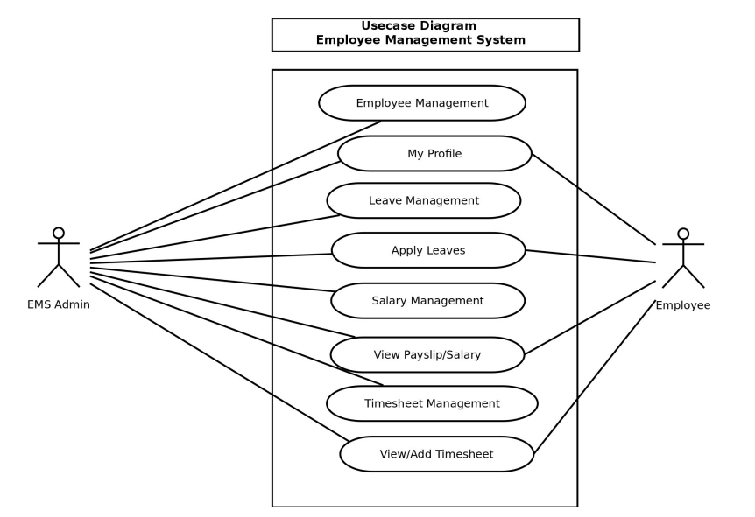
DIAGRAM

Slide 8
Conclusion
Our project is only a humble venture to satisfy the needs to manage their project work. Several user friendly coding have also adopted. This package shall prove to be a powerful package in satisfying all the requirements of the school. The objective of software planning is to provide a frame work that enables the manger to make reasonable estimates made within a limited time frame at the beginning of the software project and should be updated regularly as the project progresses.
· A description of the background and context of the project and its relation to work already done in the area. ·
Made statement of the aims and objectives of the project. ·
The description of Purpose, Scope, and applicability. ·
We define the problem on which we are working in the project. ·
We describe the requirement Specifications of the system and the actions that can be done on these things. ·
We understand the problem domain and produce a model of the system, which describes operations that can be performed on the system. ·
We included features and operations in detail, including screen layouts.
We designed user interface and security issues related to system. · Finally the system is implemented and tested according to test cases

Slide 9
Future Scope
Future Scope of the Project: In a nutshell, it can be summarized that the future scope of the project circles around maintaining information regarding: · We can add printer in future. · We can give more advance software for Employee Management System including more facilities · We will host the platform on online servers to make it accessible worldwide · Integrate multiple load balancers to distribute the loads of the system · Create the master and slave database structure to reduce the overload of the database queries · Implement the backup mechanism for taking backup of codebase and database on regular basis on different servers The above mentioned points are the enhancements which can be done to increase the applicability and usage of this project. Here we can maintain the records of employee and salary. Also, as it can be seen that now-a-days the players are versatile, i.e. so there is a scope for introducing a method to maintain the Employee Management System. Enhancements can be done to maintain all the employee, salary, leaves, attendance, registration. We have left all the options open so that if there is any other future requirement in the system by the user for the enhancement of the system then it is possible to implement them.In the last we would like to thanks all the persons involved in the development of the system directly or indirectly. We hope that the project will serve its purpose for which it is develop there by underlining success of process.

